Slide 1
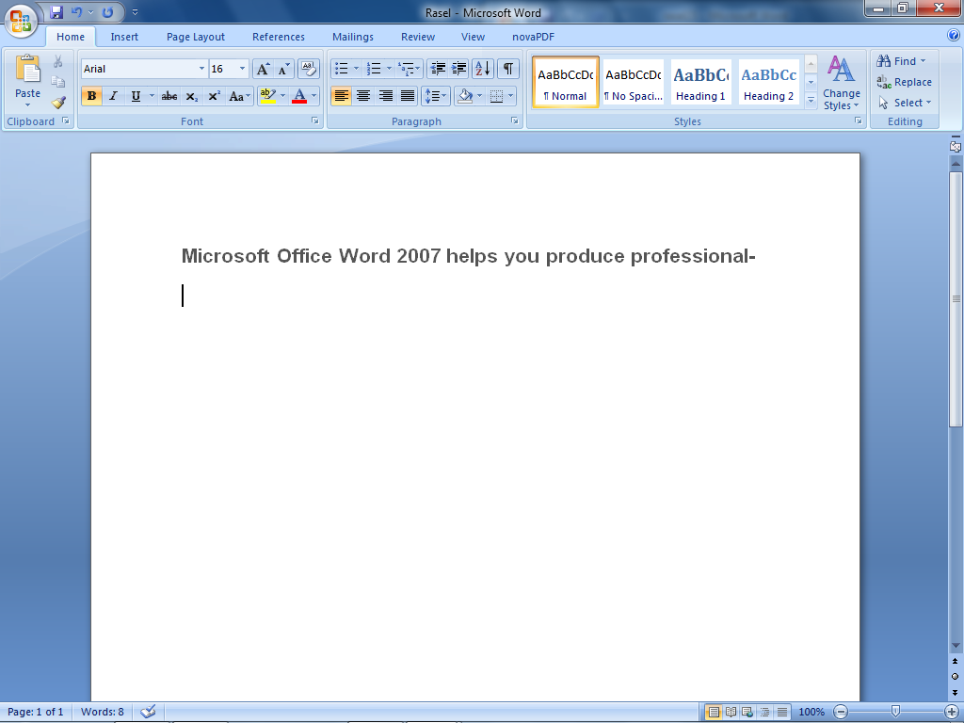

Slide 2
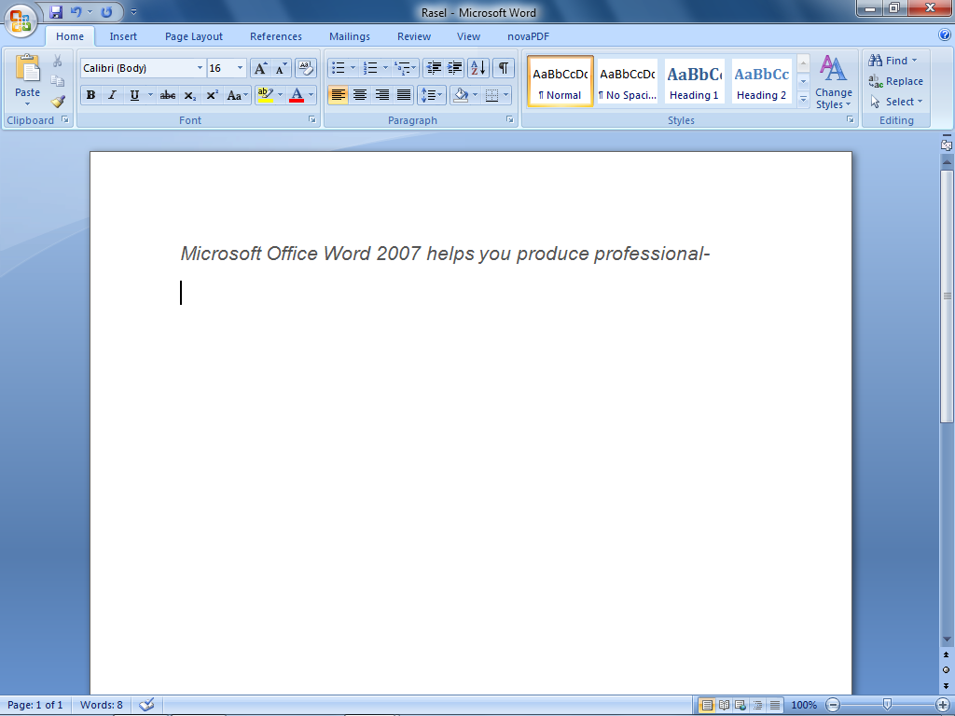

Slide 3


Slide 4
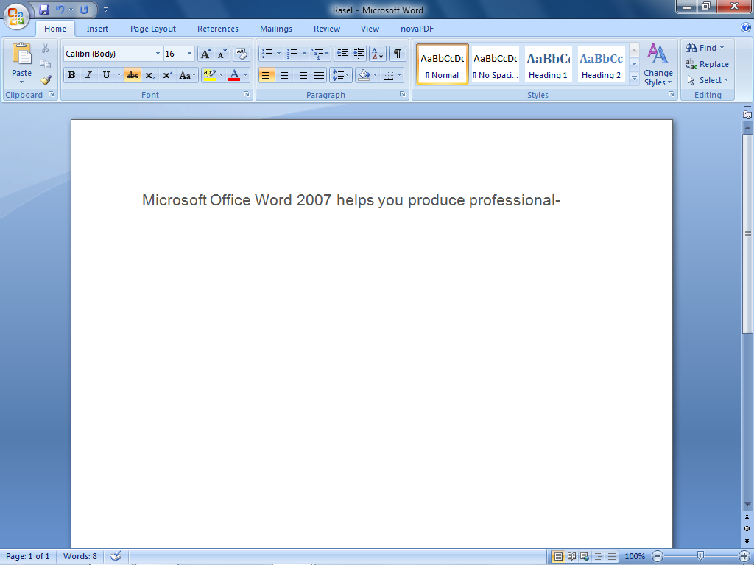

Slide 5


Slide 6
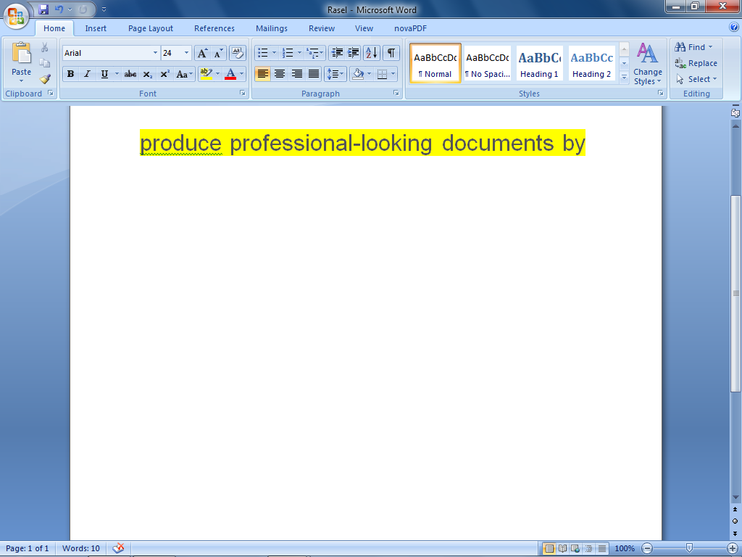
Figure: text Highlight color

Slide 7
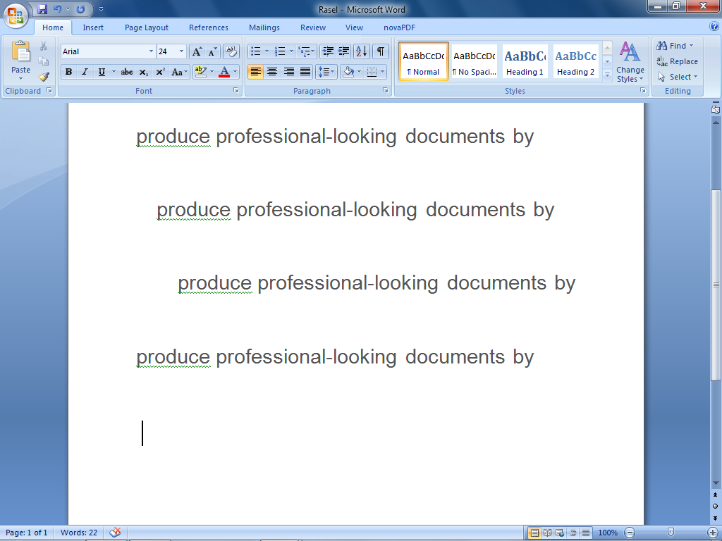
Figure : Align Text

Slide 8


Slide 9
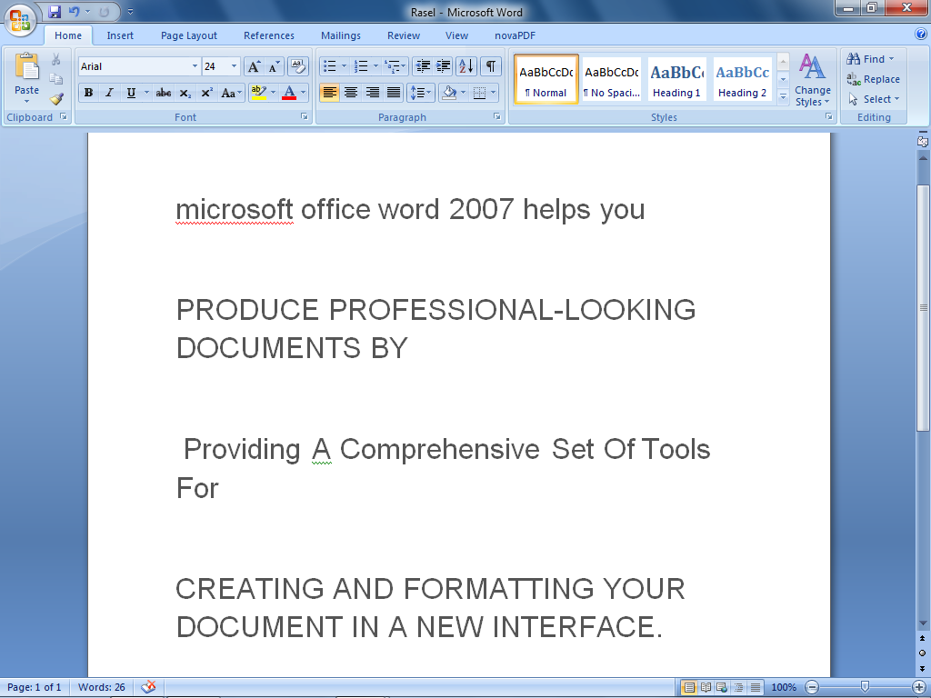

Slide 10
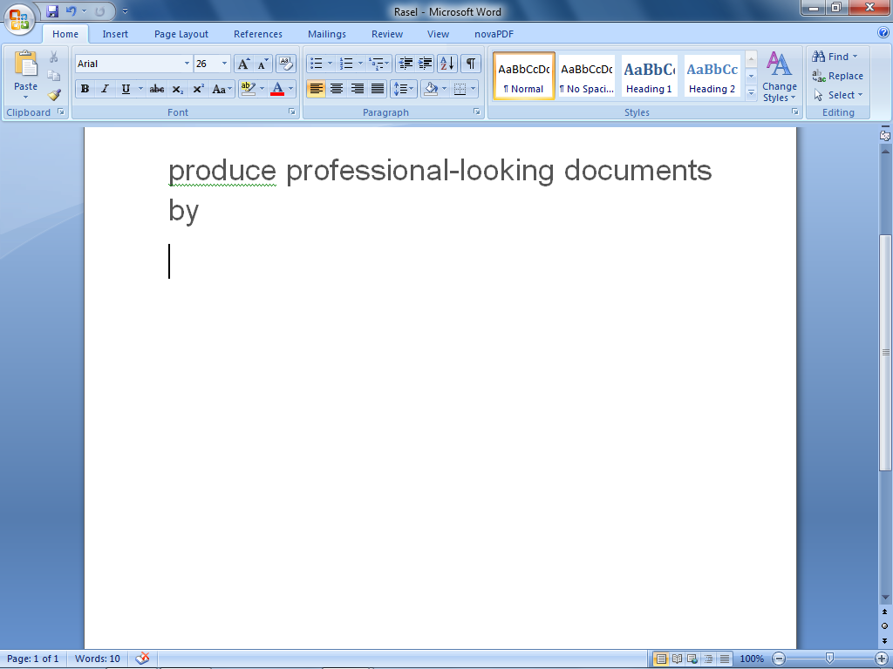
Figure: Font Size

Slide 11
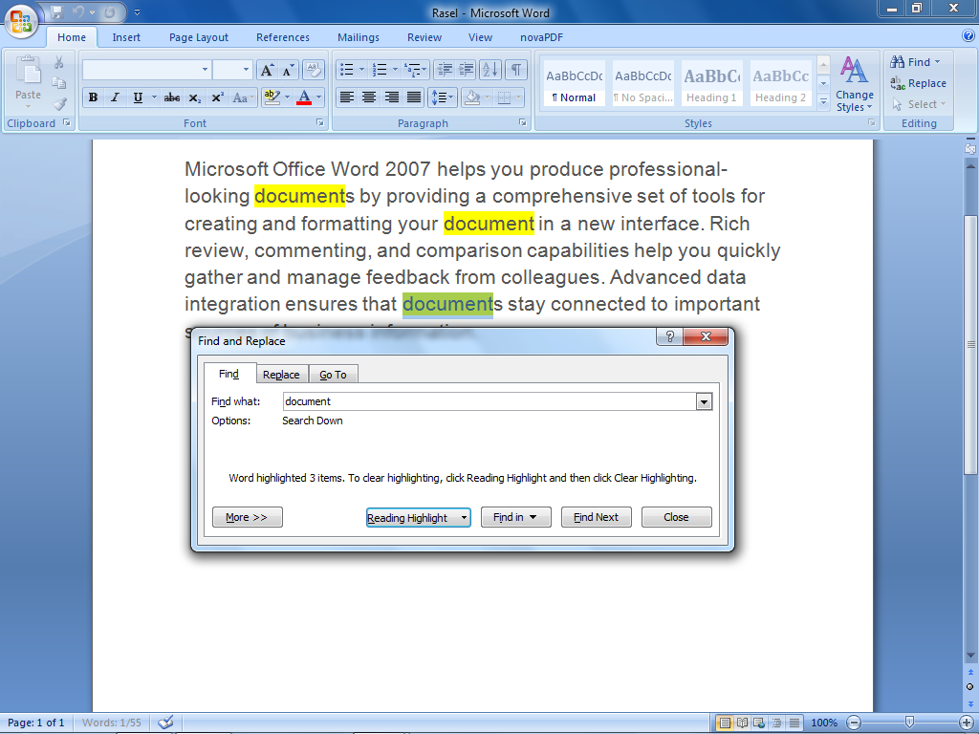
_{Home End}

Slide 12
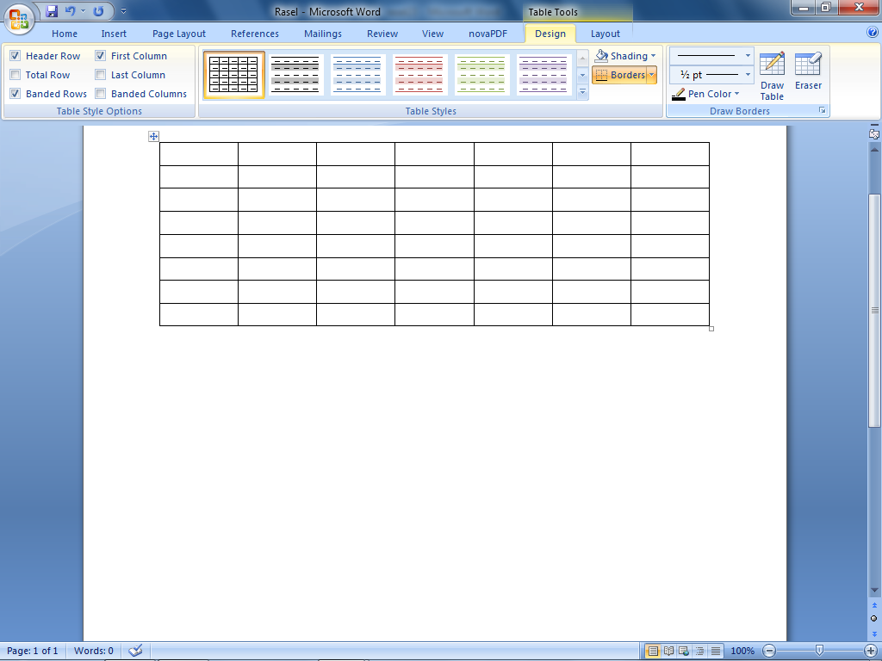
_{Insert Start:}
Figure: Table

Slide 13
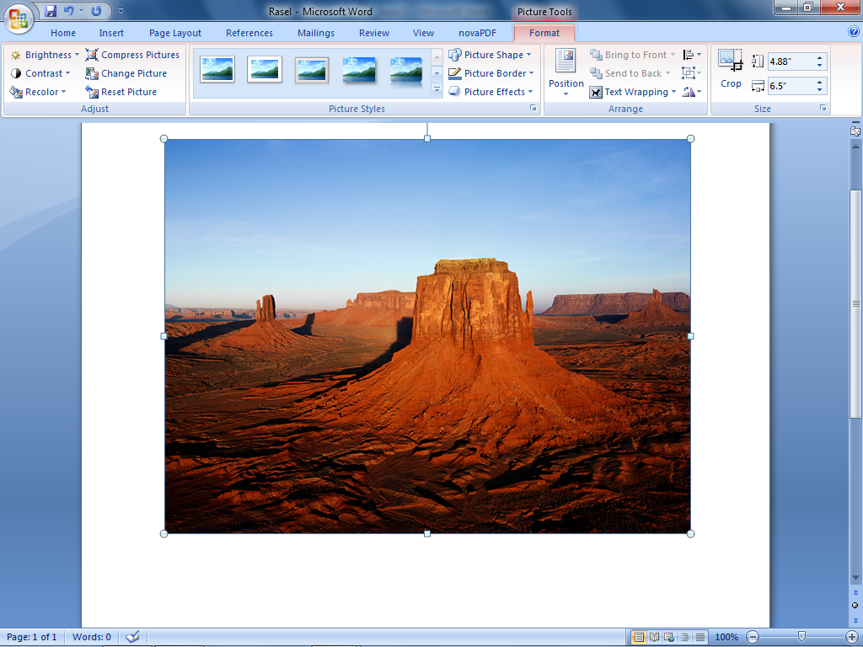
Figure:Picture

Slide 14
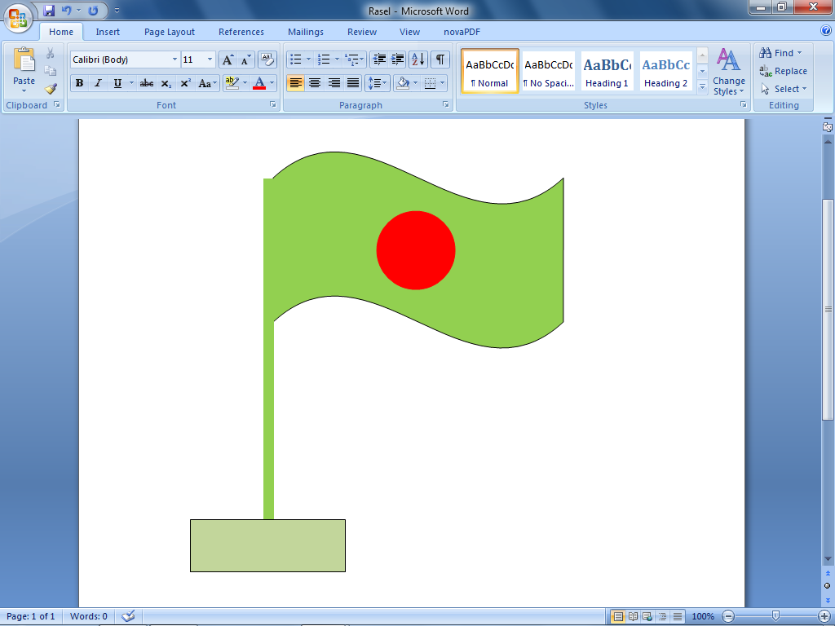
Figure :Shapes

Slide 15
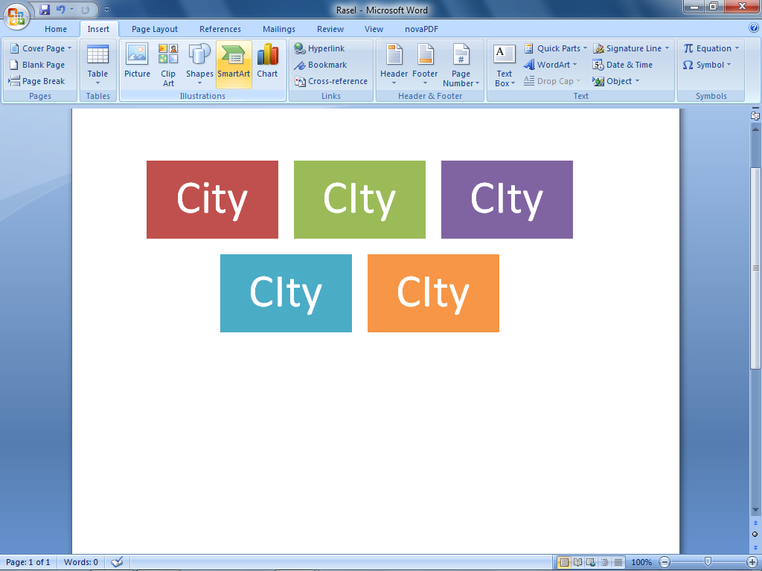
Figure: Smart art

Slide 16
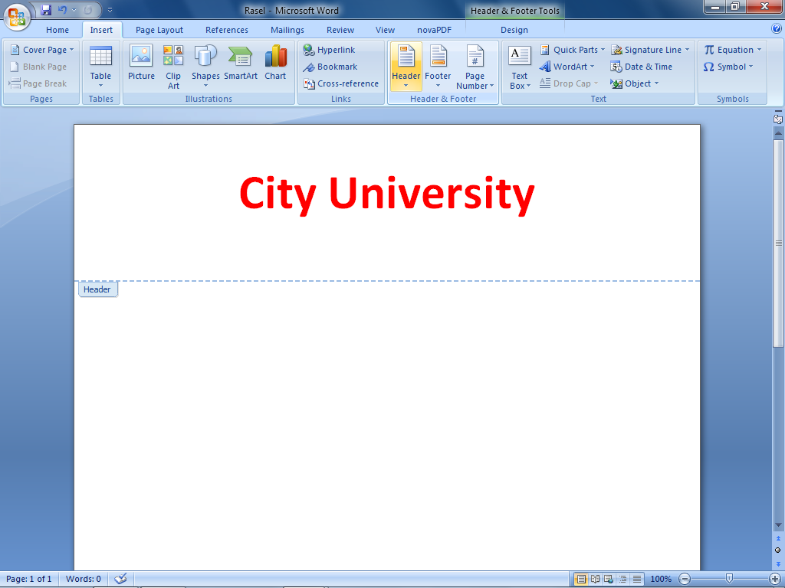
Figure: Header

Slide 17
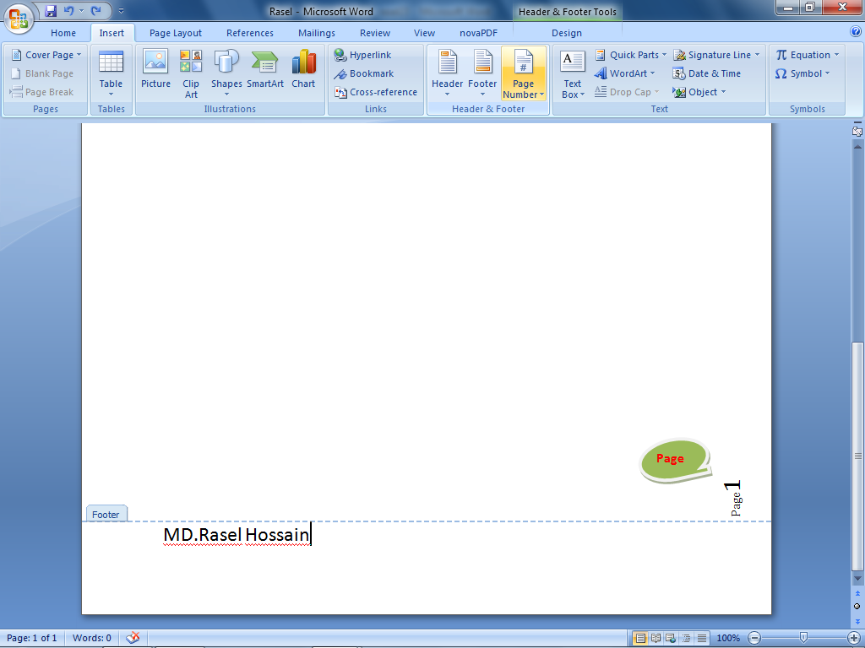
Figure: Page number

Slide 18
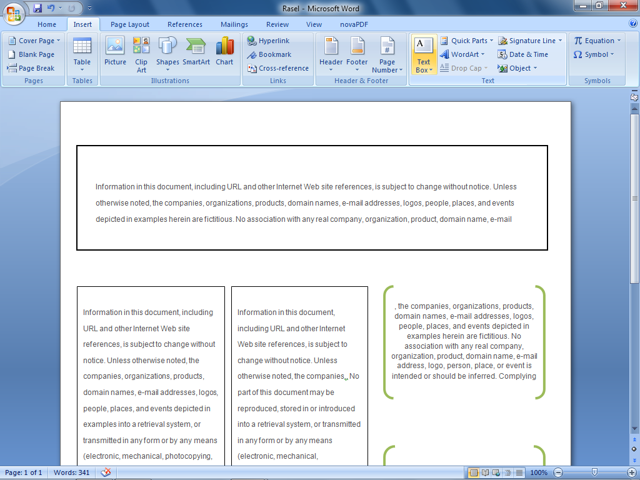
Figure: Text box

Slide 19
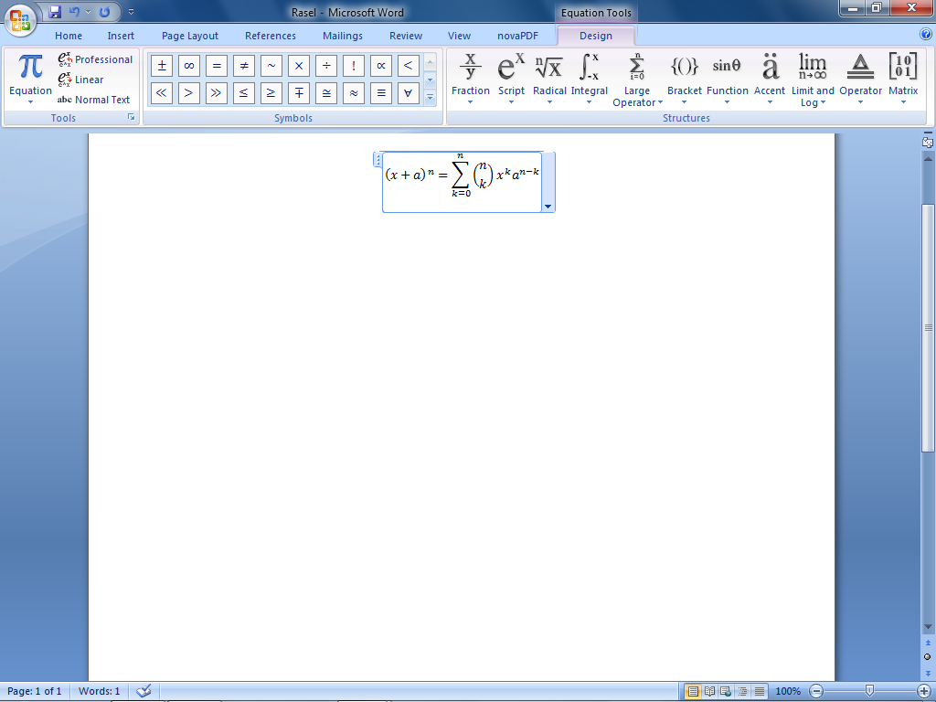
Figure: Equation

Slide 20

Figure: Cover page

Slide 21
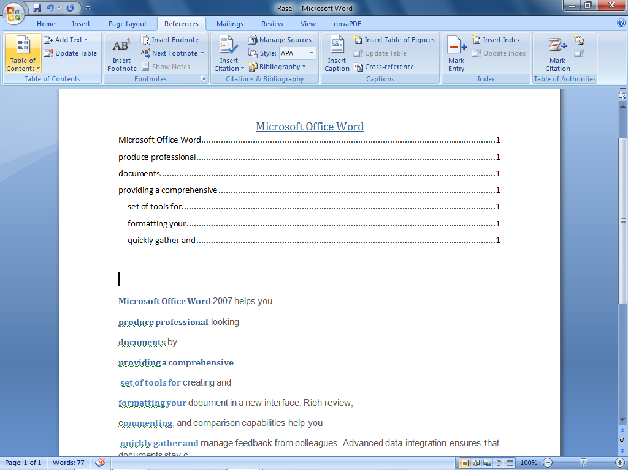
Figure: Content

Slide 22
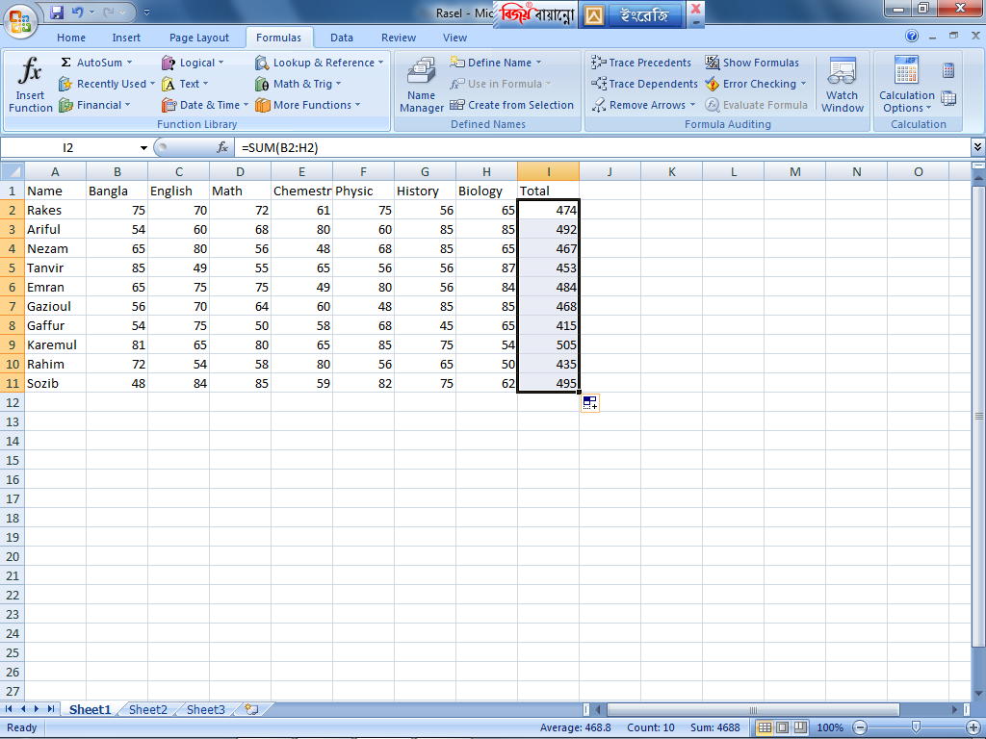
Word End: Excel Start:
Figure: Total

Slide 23
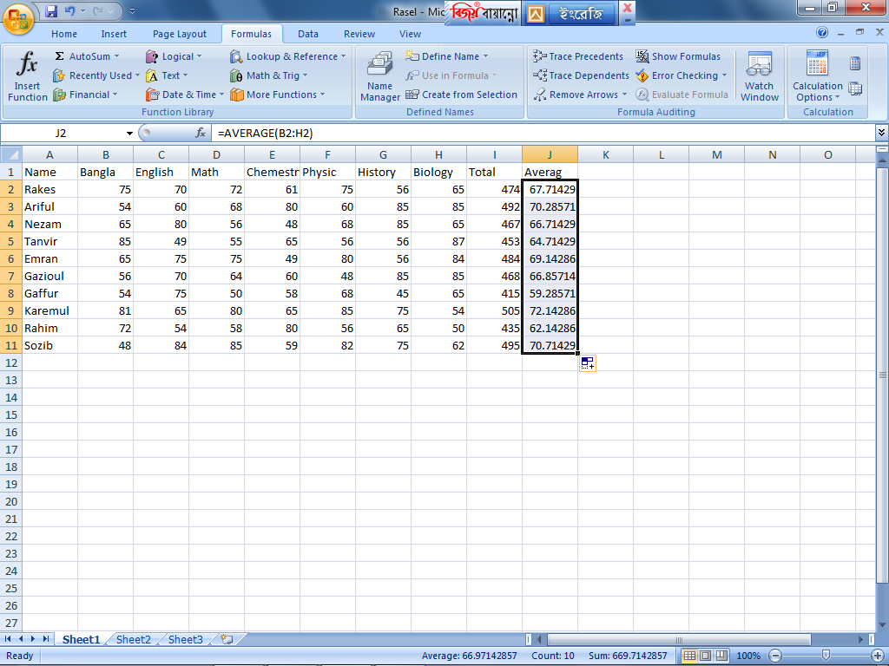
Figure: Averag

Slide 24
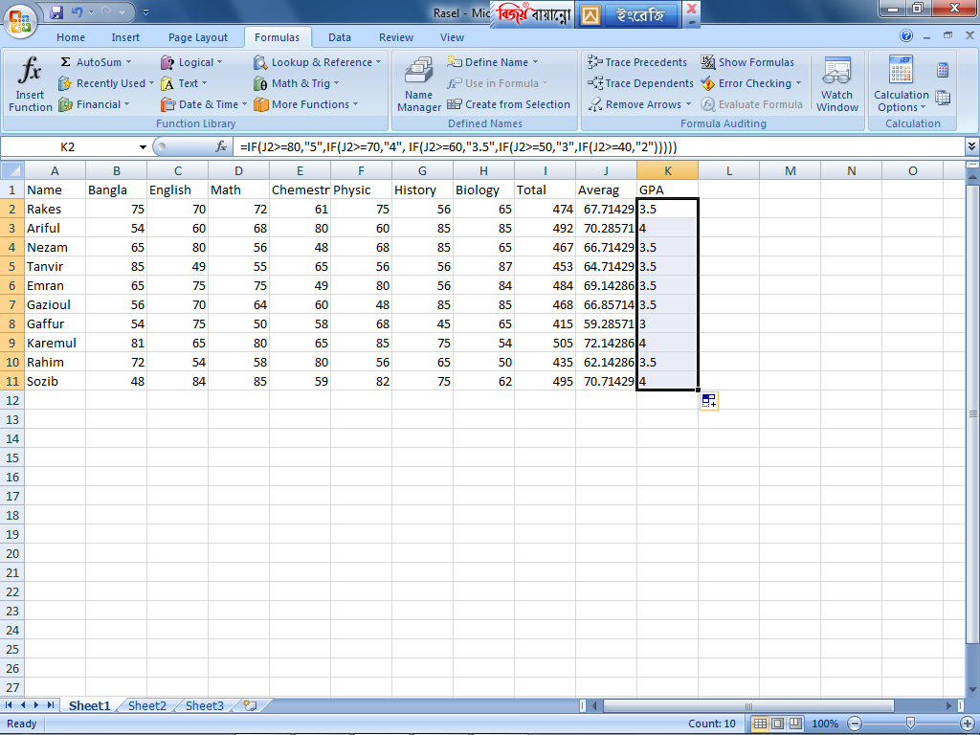
Figure:GPA

Slide 25
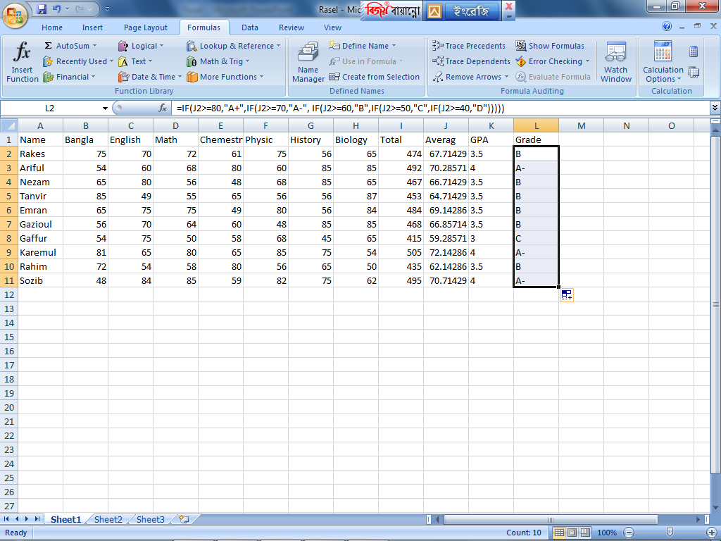
Figure:Grade

Slide 26
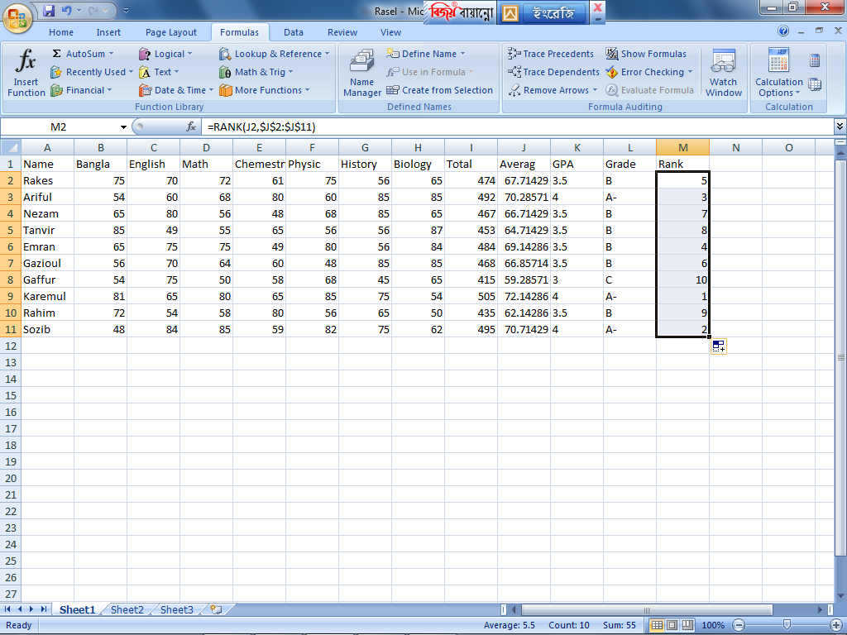
Figure: Rank

Slide 27
Code Block :

